Slide 1
Introduction to Statistical Learning

Slide 2
Definitions
Suppose we are given two variables X and Y, represented by a sample of n points of the form (x_{i}; y_{i}), for 1<= i <= n.
X and Y are correlated when the value of X has some predictive power on the value of Y.
Correlation coefficient r(X; Y )
Measures the degree to which Y is a function of X, and vice versa.
Its value ranges from -1 to 1
1 means fully correlated and 0 => n relation, i.e. independence
-ve => variables are anti-correlated, if X goes up, Y goes down.

Slide 3
The Pearson Correlation Coefficient
The elements of numerator are +ve when samples of both X and Y are greater than the mean or smaller at the same time. This would mean that they are positively correlated.
If X is usually greater than the mean when Y is less than its mean, i.e. the signs are –ve, this would mean they are –vely correlated.
Works well for linear predictors (Y = aX + b)

Slide 4
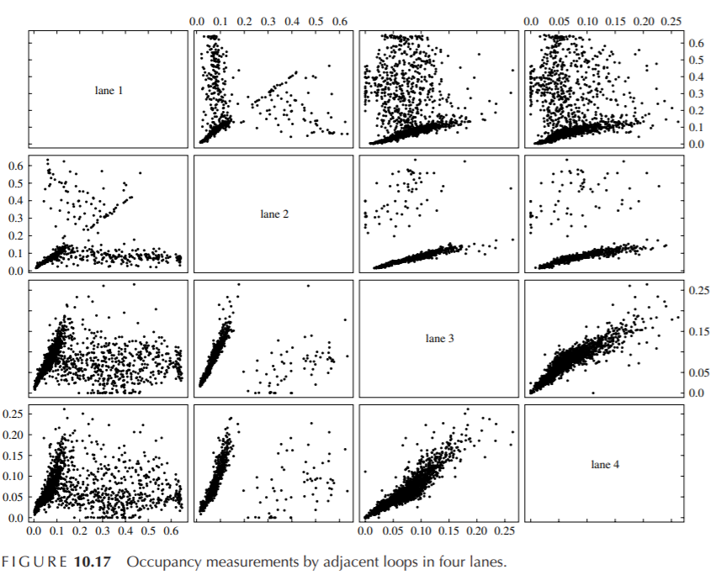
Detect defective measurements
Traffic flow measurement conducted in 4 different lanes of a highway.
The measurement device develops defects and takes incorrect readings
This can be detected by using the measurements in other lanes.

Slide 5
The Spearman Rank Correlation Coefficient
Count the number of pairs of input points which are out of order.
Suppose the data set contains points (x1; y1) and (x2; y2) where x1 < x2 and y1 < y2.
This is a vote that the values are positively correlated, whereas the vote would be for a negative correlation if y2 < y1.
Summing up over all pairs of points and normalizing properly gives us Spearman rank correlation.
This method is much more robust against outliers

Slide 6
The Spearman Rank Correlation Coefficient
Let rank(x_{i}) be the rank position of x_{i} in sorted order among all x_{i}, so the rank of the smallest value is 1 and the largest value n.
Then spearman rank correlation coefficient is,
Exercise: Prove that -1 < ρ <1 for any value of n

Slide 7
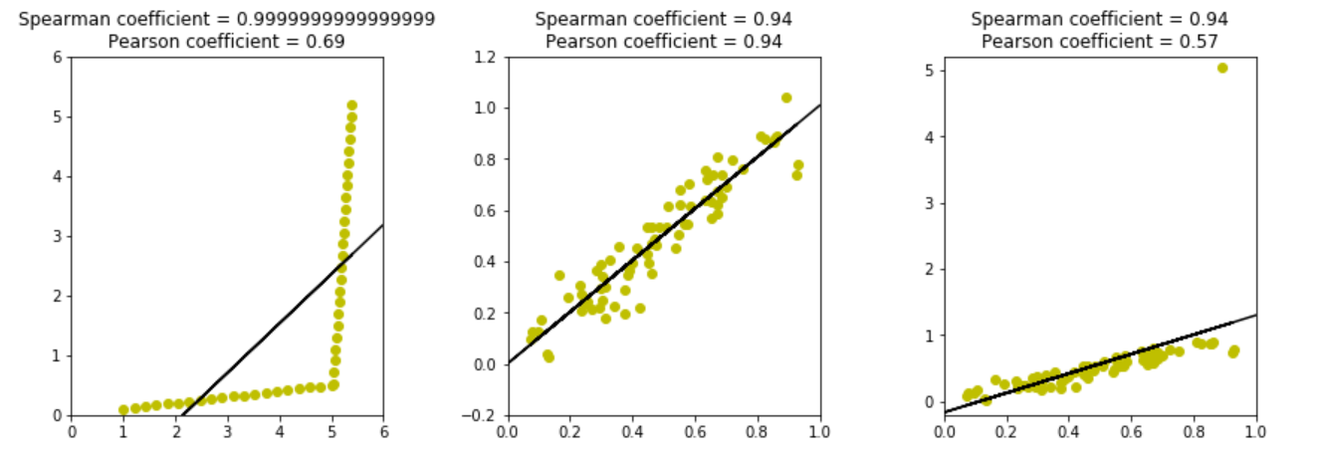
Comparison
rho, pval = stats.spearmanr(xval, yval)
pearson = stats.pearsonr(xval, yval)

Slide 8
True or False?
Taller people are more likely to remain lean
Medicine causes illness
Standardized tests like GRE, Board exams predict the performance of students in college/university
Financial status affects health
Smoking causes cancer
Active Police in an area increases crime
Wealth decreases family size

Slide 9
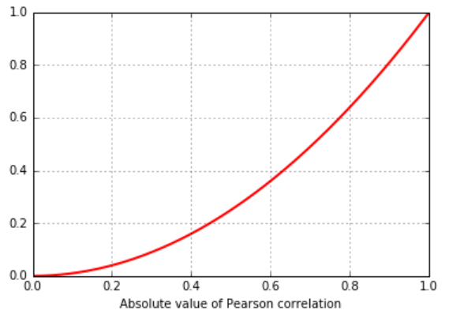
Strength of Correlation
R² : The strength of the correlation is defined as the square of the sample correlation coefficient. It estimates the fraction of variance in Y explained by X in a simple linear regression.

Slide 10
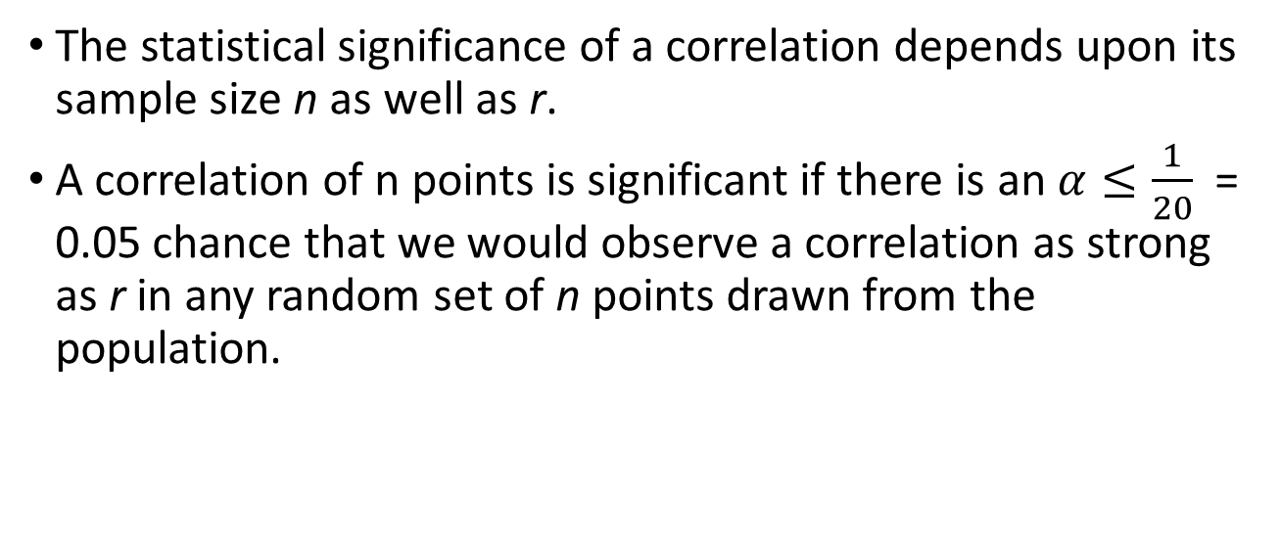
Statistical significance
The statistical significance of a correlation depends upon its sample size n as well as r.
A correlation of n points is significant if there is an $α≤\frac{1}{20}$ = 0.05 chance that we would observe a correlation as strong as r in any random set of n points drawn from the population.

Slide 11
Statistical Models

Slide 12
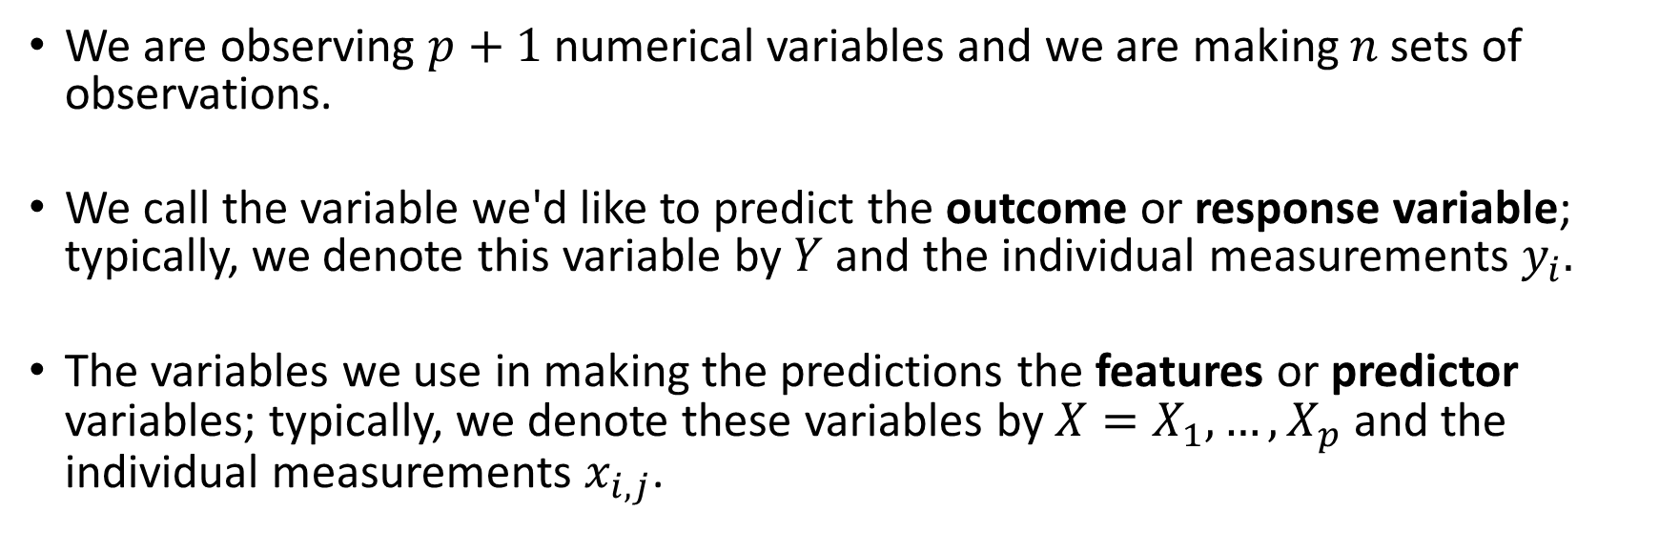
Response and Predictor Variables
We are observing $p+1$numerical variables and we are making $n$sets of observations.
We call the variable we'd like to predict the outcome or response variable; typically, we denote this variable by $Y$and the individual measurements $y_{i}.$
The variables we use in making the predictions the features or predictor variables; typically, we denote these variables by $X=X_{1},…,X_{p}$ and the individual measurements $x_{i,j}$.
Note: $i$indexes the observation ($i=1,…,n)$and $j$ indexes the value of the $j$-th predictor variable ($j=1,…,p)$. Total number of predictor variables, J=p

Slide 13
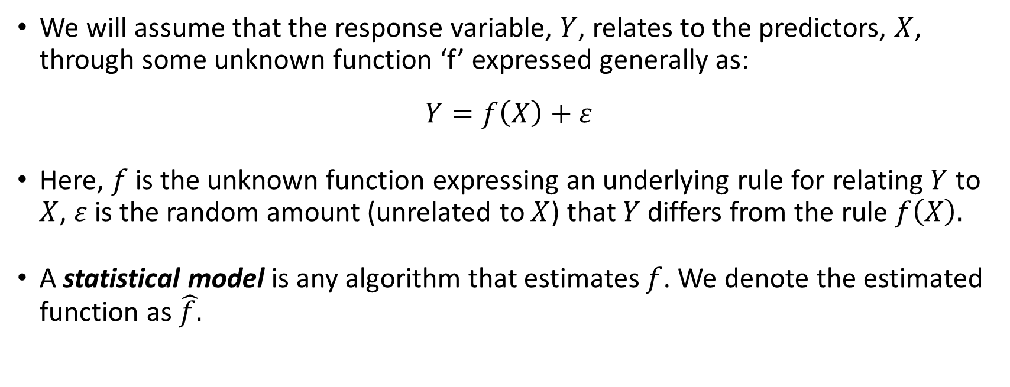
True vs. Statistical Model
We will assume that the response variable, $Y$, relates to the predictors, $X$, through some unknown function ‘f’ expressed generally as:
$$Y=f\left(X\right)+ε$$
Here, $f$ is the unknown function expressing an underlying rule for relating $Y$ to $X$, $ε$is the random amount (unrelated to $X$) that $Y$ differs from the rule $f\left(X\right).$
A statistical model is any algorithm that estimates $f$. We denote the estimated function as $\hat{f.}$
Notes:
Change x and y to uppercase? (DLS)

Slide 14
Machine Learning
Data Science Process
ML algorithms have the objective of generalization, i.e. use one dataset to generate models that perform well on data that they have not seen.
Thus, they prove to be effective in generating predictive models.
There are many ML techniques and ML models have several parameters
How to choose the best one?
Ask an interesting question
Data preparation
Explore the Data
Model the Data
Communicate/Visualize the Results

Slide 15
Machine Learning Methodology
Train Dataset
(Historical)
Random samples
Input dataset is divided into a random split (80/20) or (90/10) to be used for training and testing respectively
For each split, model is generated and tested for accuracy
This is repeated 5 times or 10 times and average error is computed
The best model is selected and used in real world scenario
Training set
Test set
Apply ML algos
Test Data (Real)
Best Model
Validate
Results

Slide 16
Goals of Machine Learning
Prediction: We are only interested in the correct output “y”. The model may be black-box, we may not know the relationships between x and y and which attributes influence y in what way etc.
Inference: We are more interested in the relationships of the attributes with “y”. We want to know which attributes are more important, how they influence “y”.
Inference + Prediction: We are interested in both.

Slide 17
Flexibility vs. Interpretability Tradeoff
There are many methods of regression (that estimate f)
Some are less flexible but more interpretable
These are useful for inference problems where we want to study the relationships between predictor variables
But highly flexible methods can also lead to over-fitting!

Slide 18
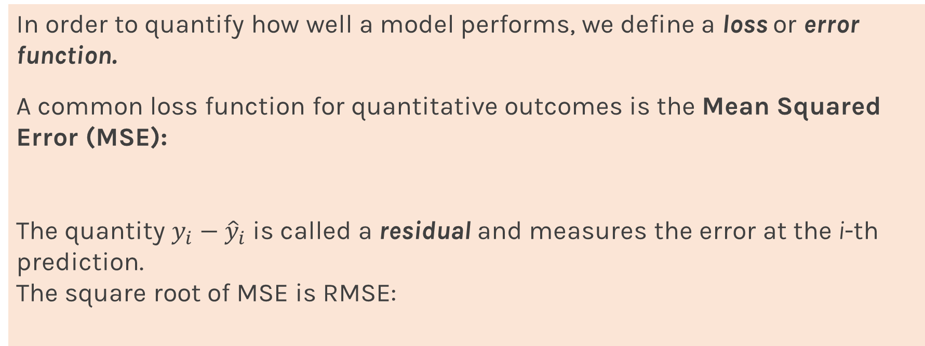
Error Evaluation
In order to quantify how well a model performs, we define a loss or error function.
A common loss function for quantitative outcomes is the Mean Squared Error (MSE):
The quantity $y_{i}−{\hat{y}}_{i}$ is called a residual and measures the error at the i-th prediction.
The square root of MSE is RMSE:
Notes:
Change indeces and show k-nearest

Slide 19
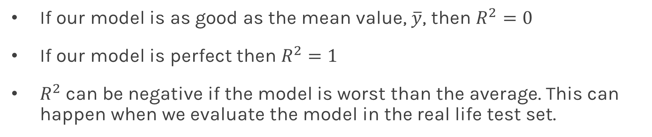
R-squared Error
If our model is as good as the mean value, $\overline{y}$, then $R^{2}=0$
If our model is perfect then $R^{2}=1$
$R^{2}$ can be negative if the model is worst than the average. This can happen when we evaluate the model in the real life test set.

Slide 20
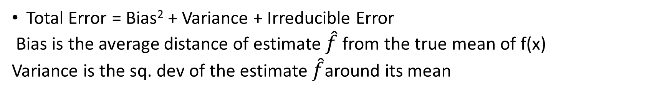
Bias Variance Tradeoff
Total Error = Bias² + Variance + Irreducible Error
Bias is the average distance of estimate $\hat{f}$ from the true mean of f(x)
Variance is the sq. dev of the estimate $\hat{f}$around its mean

Slide 21
Bias Variance Tradeoff
“All models are wrong, but some models are useful.” : George Box (1919-2013)
Occam’s razor: This philosophical principle states that “the simplest explanation is best”.
Bias is error from erroneous assumptions in the model, like making it linear/simplistic. (underfitting)
Variance is error from sensitivity to small fluctuations in the training set, indicating it will not work in real world. (overfitting)
First-principle models likely to suffer from bias, with data-driven models in greater danger of overfitting.

Slide 22
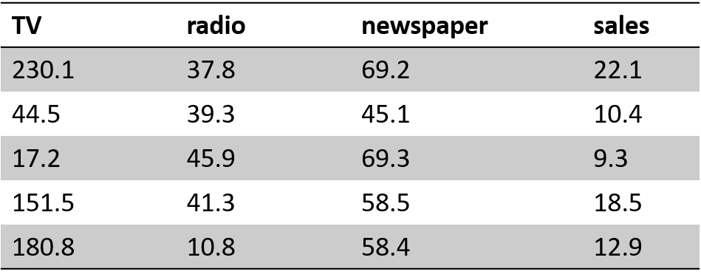
Example Problem (Advertising)
The Advertising data set consists of the sales of that product in 200 different markets, along with advertising budgets for the product in each of those markets for three different media: TV, radio, and newspaper. Everything is given in units of $1000.
Some of the figures in this presentation are taken from ISL book: "An Introduction to Statistical Learning, with applications in R" (Springer, 2013) with permission from the authors: G. James, D. Witten, T. Hastie and R. Tibshirani "

Slide 23
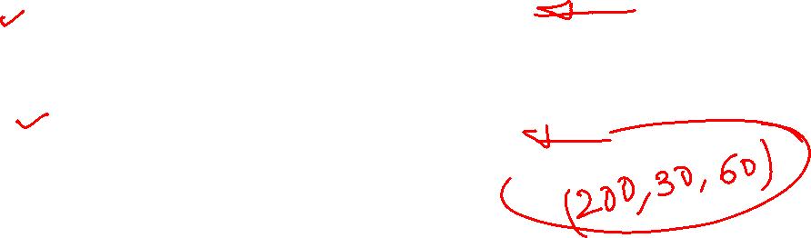
Response vs. Predictor Variables
X
predictors
features
covariates
Y
outcome
response variable
dependent variable
TV | radio | newspaper | sales
230.1 | 37.8 | 69.2 | 22.1
44.5 | 39.3 | 45.1 | 10.4
17.2 | 45.9 | 69.3 | 9.3
151.5 | 41.3 | 58.5 | 18.5
180.8 | 10.8 | 58.4 | 12.9
n observations
p predictors

Slide 24
k-Nearest Neighbors
The k-Nearest Neighbor (kNN) model is an intuitive way to predict a quantitative response variable:
to predict a response for a set of observed predictor values, we use the responses of other observations most similar to it
Note: this strategy can also be applied in classification to predict a categorical variable.
Notes:
Change indeces and show k-nearest

Slide 25
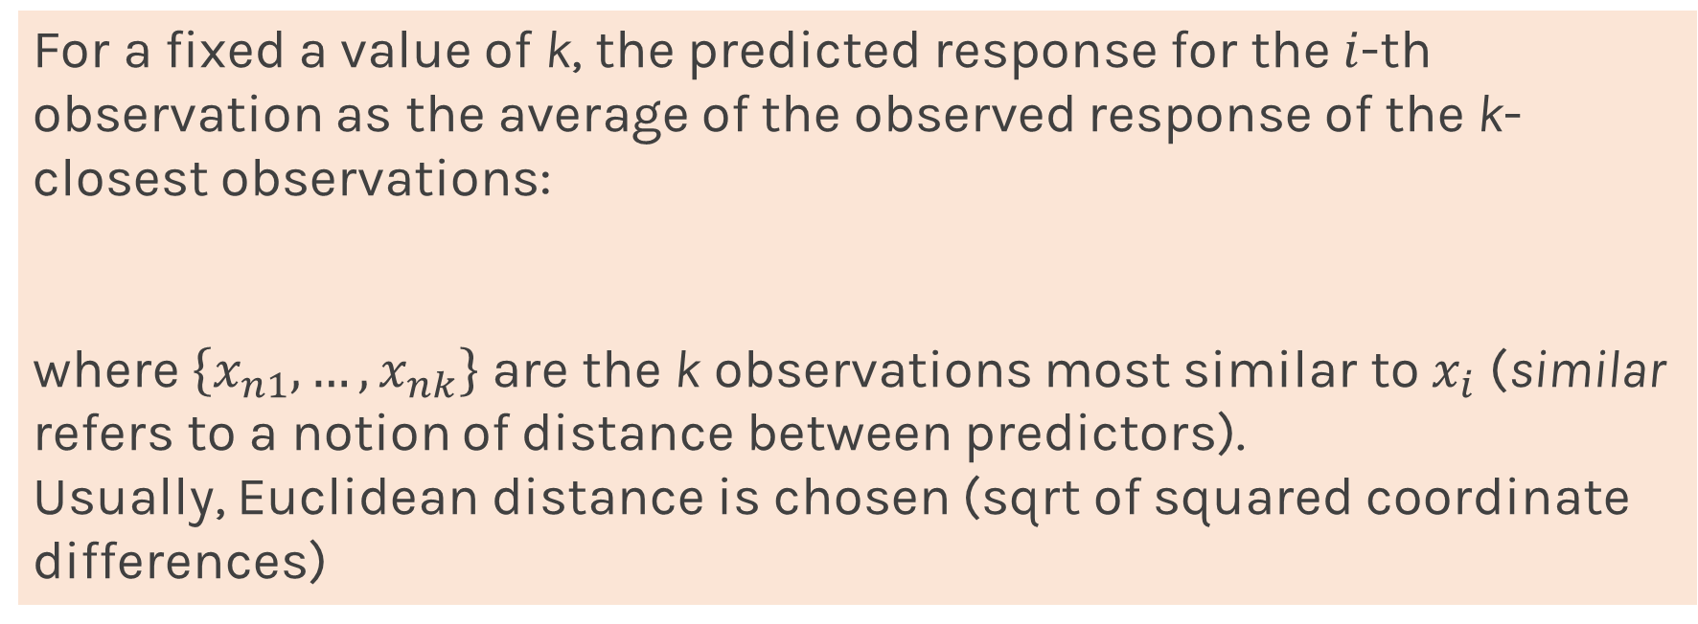
k-Nearest Neighbors
For a fixed a value of k, the predicted response for the $i$-th observation as the average of the observed response of the k-closest observations:
where $\left\{x_{n1},…,x_{nk}\right\}$ are the k observations most similar to $x_{i}$ (similar refers to a notion of distance between predictors).
Usually, Euclidean distance is chosen (sqrt of squared coordinate differences)
Python: sklearn.neighbors.KNeighborsRegressor(n_neighors=3)
Notes:
Change indeces and show k-nearest

Slide 26



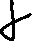


4-Nearest Neighbors
Very few assumptions made here about the nature of ‘f’
Equal weights for the values of y, regardless of their distance from x
As dimensionality increases, becomes hard to find neighbors closeby and f may change significantly

Slide 27

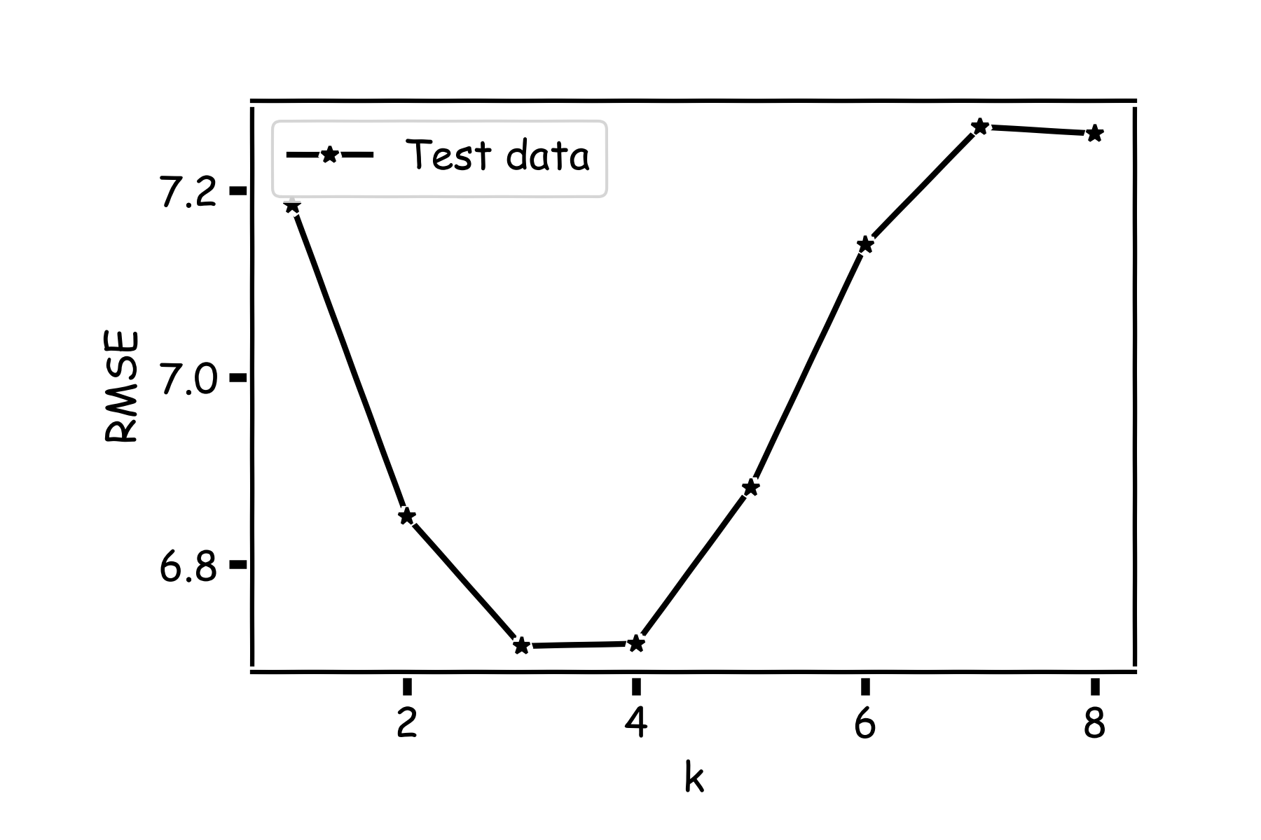
Model Comparison
Do the same for all k’s and compare the RMSEs
Which k is best?
Q. Reason for discontinuity
Q. Bias Variance tradeoff

Slide 28
Linear Models
In the kNN approach, we didn’t assume a form of the function ‘f’
Such approaches are called non-parametric approaches
In the linear regression approach, we assume that the response is a linear function of the predictor variables
Note that this technique can be easily extended by creating extra predictor variables (features) from a combination (transformation) of the original predictor variables.
So lets assume:

Slide 29
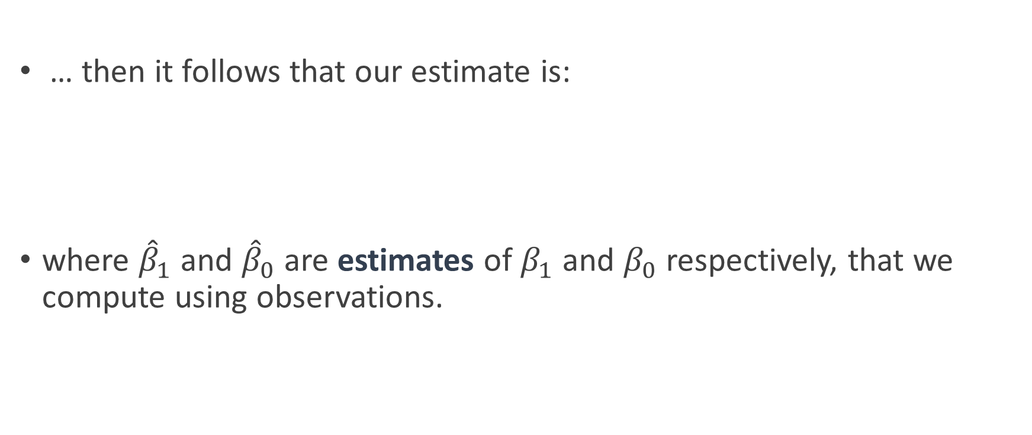
Linear Regression
… then it follows that our estimate is:
where ${\hat{β}}_{1}$ and ${\hat{β}}_{0}$are estimates of $β_{1}$ and $β_{0}$ respectively, that we compute using observations.

Slide 30
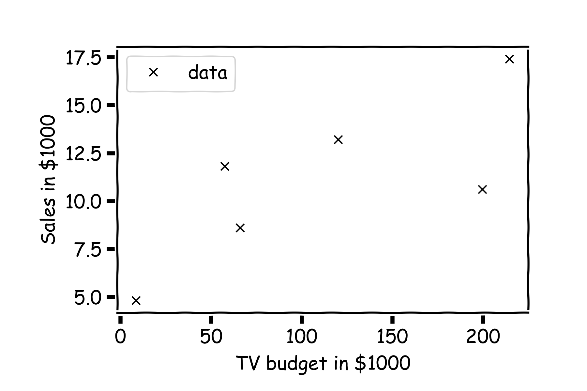
Estimate of the regression coefficients
For a given data set

Slide 31
Estimate of the regression coefficients (cont)
Which of the above three lines fit the data points the best?
One which goes through maximum number of points
One with least slope
One from which no point is too far, i.e. it is approximately in middle of all points

Slide 32
Estimate of the regression coefficients (cont)
To compute the best fit, we first calculate the residuals

Slide 33
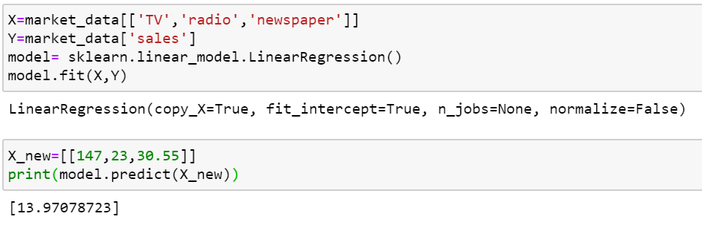
Python package

Slide 34
So how do Linear Regression solvers work?
Matrix Methods
Exact methods that solve the set of linear equations
Involve computation of matrix inverse or pseudoinverse (more efficient)
Gradient Descent
A generic method of solving optimization problems
Begin with a random point and reach the optimal solution through a sequence of improvements
Faster improvements could be done by stochastic methods

Slide 35
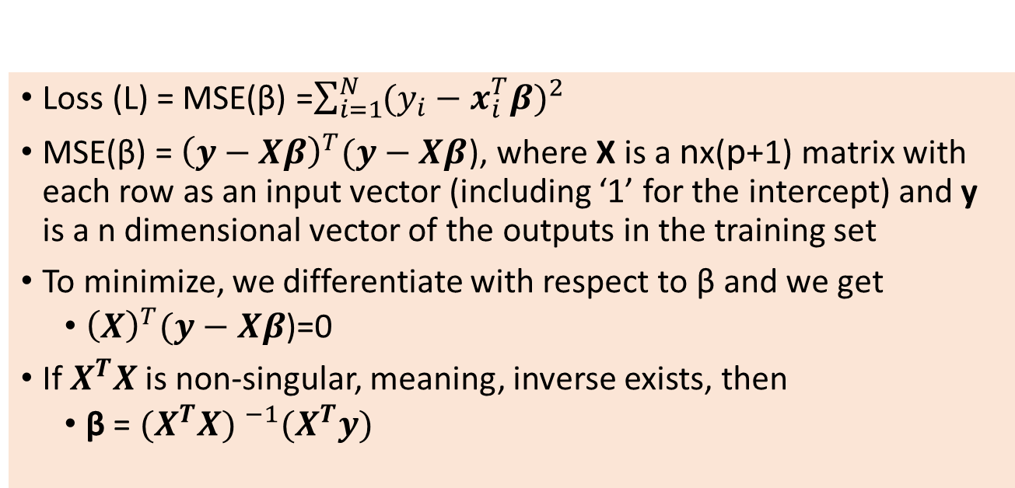
Matrix Algebra for n-dimensions
Loss (L) = MSE(β) =$\sum_{i=1}^{N }{{(y_{i}−x_{i}^{T}β)}^{2} }$
MSE(β) = ${\left(y−Xβ\right)}^{T}(y−Xβ$), where X is a nx(p+1) matrix with each row as an input vector (including ‘1’ for the intercept) and y is a n dimensional vector of the outputs in the training set
To minimize, we differentiate with respect to β and we get
${\left(X\right)}^{T}(y−Xβ$)=0
If $X^{T}X$is non-singular, meaning, inverse exists, then
β = ${(X^{T}X) }^{−1}(X^{T}y)$

Slide 36
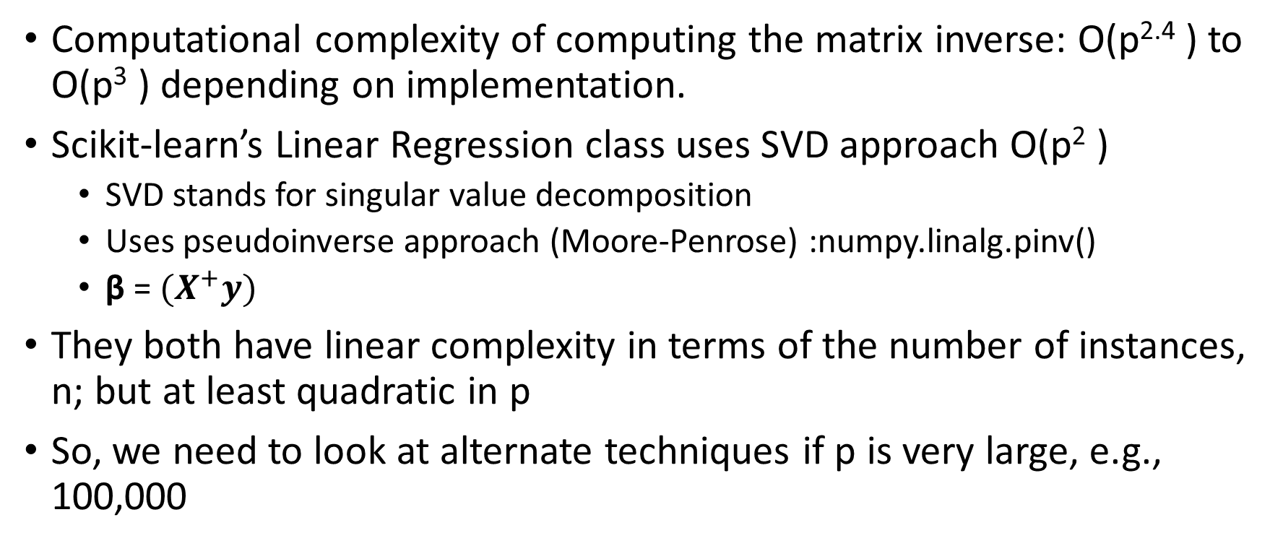
Matrix Algebra for n-dimensions
Computational complexity of computing the matrix inverse: O(p^{2.4} ) to O(p³ ) depending on implementation.
Scikit-learn’s Linear Regression class uses SVD approach O(p² )
SVD stands for singular value decomposition
Uses pseudoinverse approach (Moore-Penrose) :numpy.linalg.pinv()
β = $(X^{+}y)$
They both have linear complexity in terms of the number of instances, n; but at least quadratic in p
So, we need to look at alternate techniques if p is very large, e.g., 100,000

Slide 37
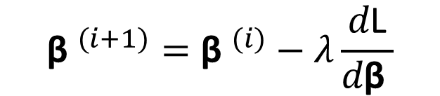
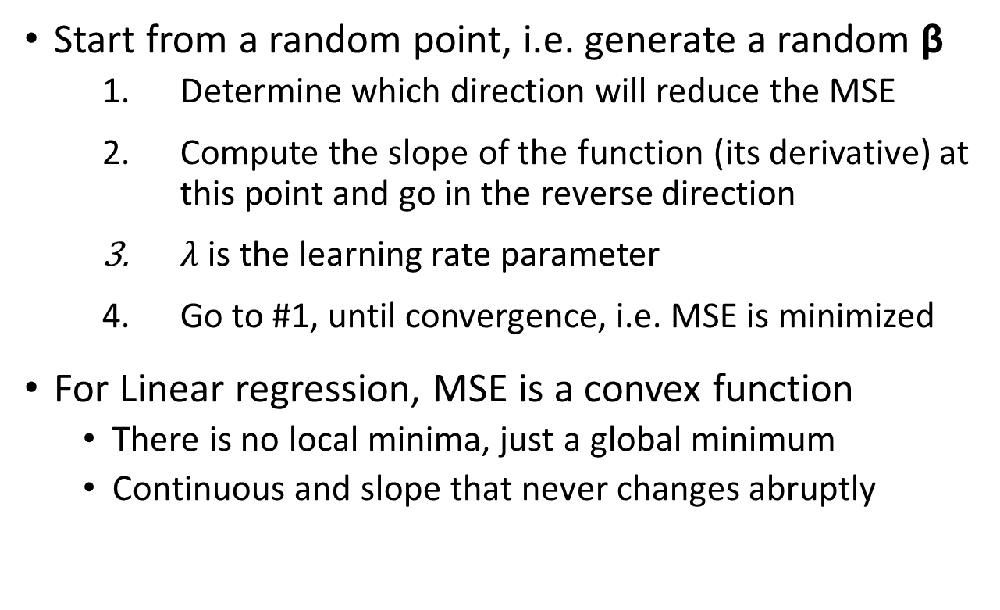
Gradient Descent Approach
Start from a random point, i.e. generate a random β
Determine which direction will reduce the MSE
Compute the slope of the function (its derivative) at this point and go in the reverse direction
$λ$ is the learning rate parameter
Go to #1, until convergence, i.e. MSE is minimized
For Linear regression, MSE is a convex function
There is no local minima, just a global minimum
Continuous and slope that never changes abruptly
$${{\text{β} }^{(i+1)}=\text{β} }^{(i)}−λ\frac{d\text{L}}{d\text{β} }$$
-
+
L
β

Slide 38
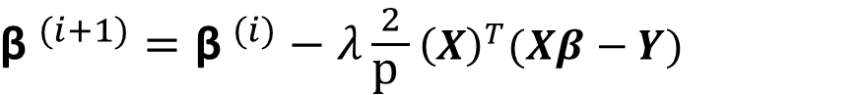
Stochastic Approaches
${{\text{β} }^{(i+1)}=\text{β} }^{(i)}−λ\frac{2}{\text{p} }$ ${\left(X\right)}^{T}(Xβ−Y)$
Batch GD update equation
Uses the whole batch of training data at each gradient step
Stochastic GD
Picks only a random instance of training data to update gradients
Causes irregular descent, but better chance of finding global minimum
Simulated annealing: Reduce the learning rate gradually to reduce irregularity
Mini-batch GD
Small set of random instances of training data are used

Slide 39
Parametric or Non-Parametric?
 | Linear Regression (parametric) | k-NN Approach (non-parametric)
Assumption on function f | A linear function is assumed | Can work even if the function is non-linear. But it has to be locally constant
High dimensions | Complexity problems which can be overcome by efficient algorithms | Difficult to find neighbors nearby which can cause errors
Bias | Low (if true function is linear) High (if true function is non-linear) | Small K=> Low bias Large K => High Bias
Variance | Depends on the problem | Small K=> High Variance Large K => Low Variance
Computations | Once during the model fitting phase. After that predictions are quick | Every time a prediction has to be made, we look at all the training points

Slide 40
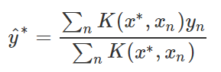
kNN: Kernel Regression
What if we took all the points, not just the k nearest points, and introduced a weighting function that weights by distance (so that we weight the value of closer points more)?
Traditional kNN method can be seen as a 0/1 weighting model
Examples of kernels: Epanechnikov quadratic kernel, Tri-cube Kernel, and Gaussian Kernel.

Slide 41
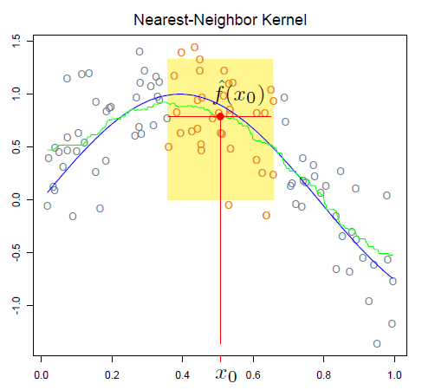
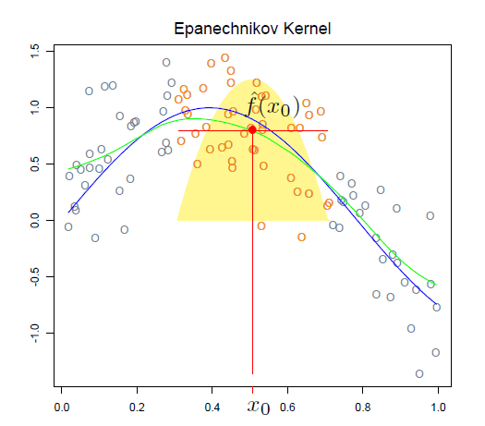
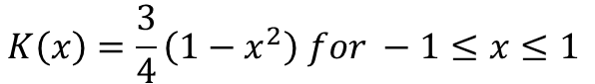
Comparison of Kernels
$$K\left(x\right)=\frac{3}{4}\left(1−x^{2}\right) for −1≤x≤1$$

Slide 42
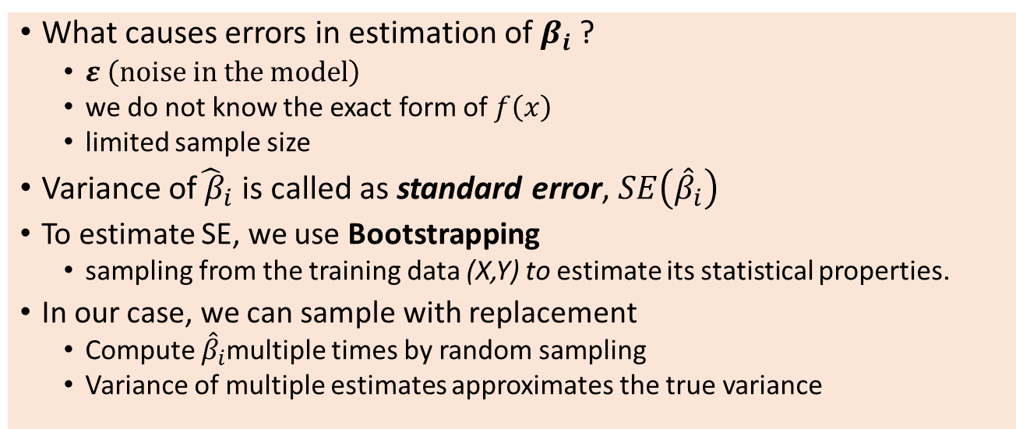
Confidence intervals for predictor estimators
What causes errors in estimation of $β_{i}$ ?
$ε \left(noise in the model\right)$
we do not know the exact form of $f\left(x\right)$
limited sample size
Variance of${\hat{ β}}_{i}$ is called as standard error,$SE\left({\hat{β}}_{i}\right)$
To estimate SE, we use Bootstrapping
sampling from the training data (X,Y) to estimate its statistical properties.
In our case, we can sample with replacement
Compute ${\hat{β}}_{i}$multiple times by random sampling
Variance of multiple estimates approximates the true variance

Slide 43
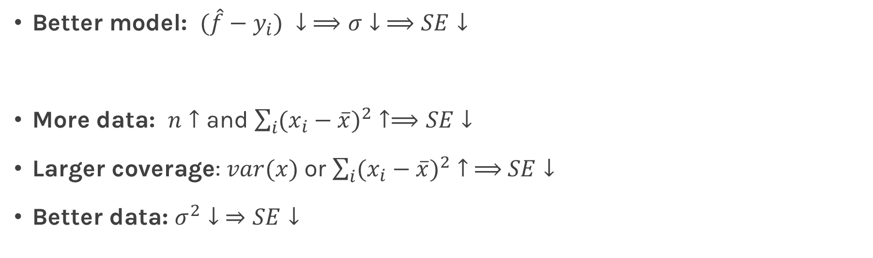
Standard Errors Intuition from Formulae
Better model: $(\hat{f}−y_{i}) ↓$ $⟹σ↓ ⟹SE↓$
More data: $n↑$ and $\sum_{i}{({x_{i}−\overline{x})}^{2}}↑⟹SE↓$
Larger coverage: $var(x)$ or $\sum_{i}{({x_{i}−\overline{x})}^{2}}↑ ⟹$ $SE↓$
Better data: $σ^{2}↓ ⇒SE↓$
$$General Formula: SE{\left(β\right)}^{2}=σ^{2}{\left(X^{T}X\right)}^{−1}$$

Slide 44
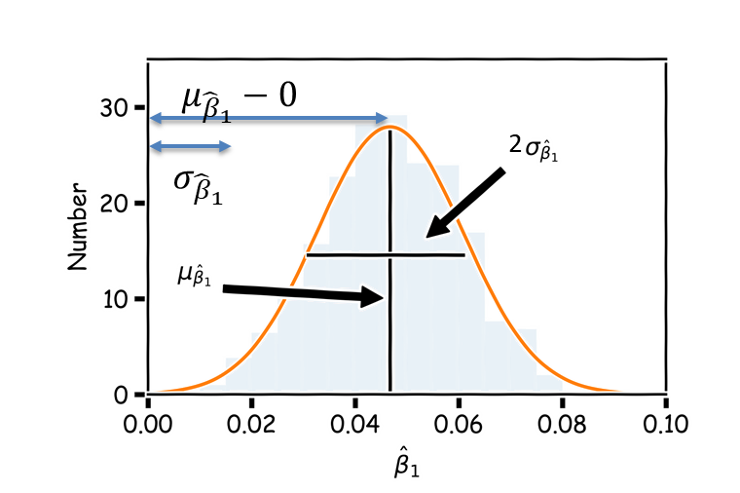
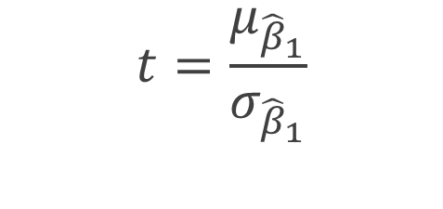
Significance of predictor variables
As we saw, there are inherent uncertainties in estimation of β
We evaluate the importance of predictors using hypothesis testing, using the t-statistics and p-values (Small p-value(<0.05) => significant)
Null hypothesis is that β_{i}=0
Test statistic here would be
Which measures the distance of the mean from zero in units of standard deviation.

Slide 45
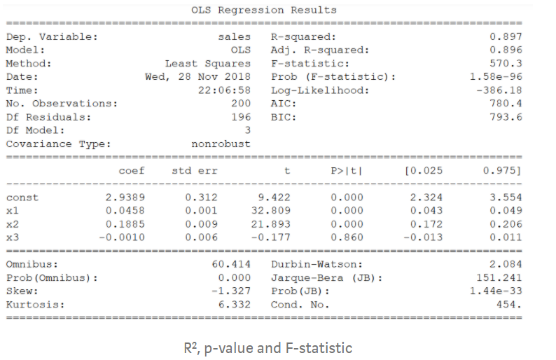
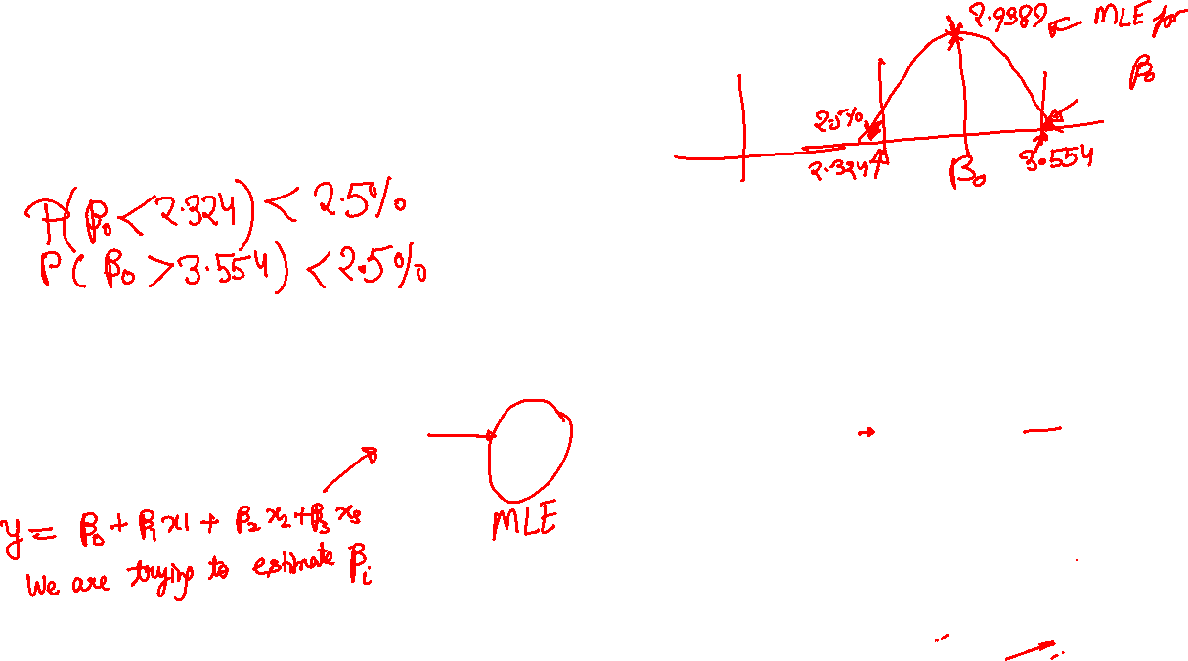
Sample Results
import statsmodels.api as sm
est = sm.OLS(y, X2) est2 = est.fit() print(est2.summary())

Slide 46
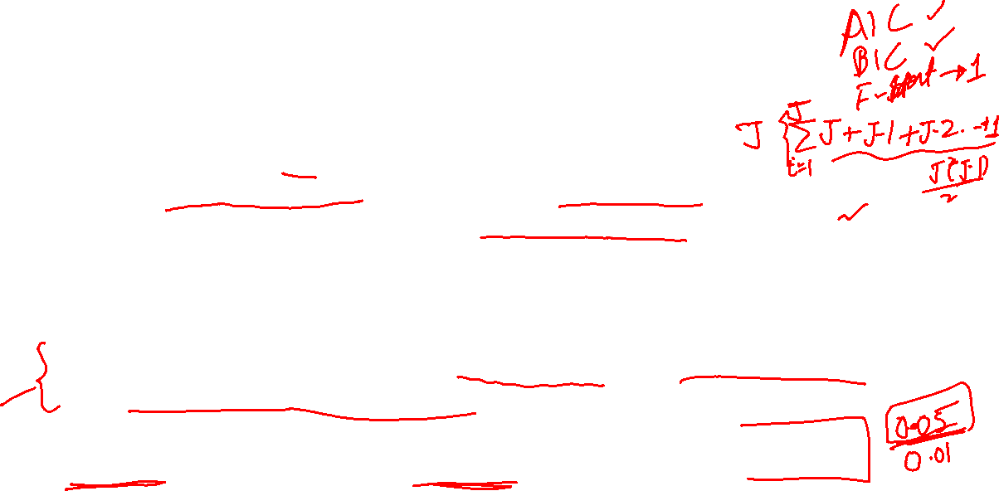
Subset Selection Techniques
Forward selection:
Begin will a null set, S
Perform J linear regressions, each with exactly one variable
Add the variable that results in lowest Cross-validation error to the set, S
Again, perform J-1 linear regressions with 2 variables
Add the variable that results in lowest Cross-validation error to the set, S
Continue until some stopping criteria is reached… eg. CV error is not decreasing
Backward selection begins with all the variables and removes the variable with highest p-value at successive steps
Mixed selection is similar to Forward Selection, but it may also remove a variable if it doesn’t yield any improvement to the model

Slide 47
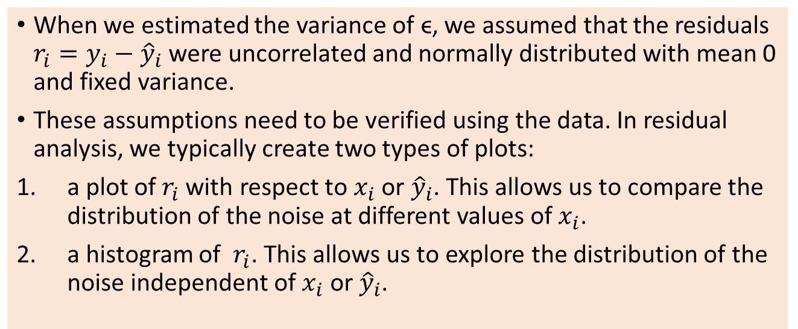

Do I need more predictors/change of model?
When we estimated the variance of ϵ, we assumed that the residuals $r_{i}=y_{i}−{\hat{y}}_{i}$ were uncorrelated and normally distributed with mean 0 and fixed variance.
These assumptions need to be verified using the data. In residual analysis, we typically create two types of plots:
a plot of${ r}_{i}$with respect to $x_{i}$ or ${\hat{y}}_{i}$. This allows us to compare the distribution of the noise at different values of $x_{i}$.
a histogram of ${ r}_{i}$. This allows us to explore the distribution of the noise independent of $x_{i}$ or ${\hat{y}}_{i}$.

Slide 48
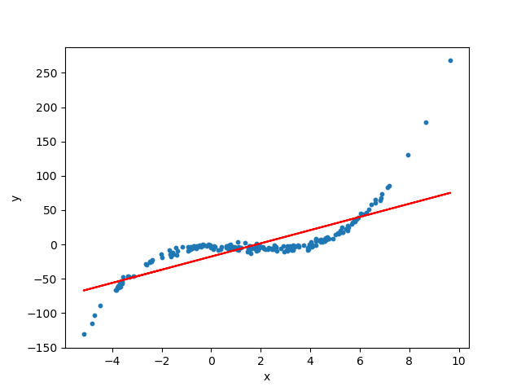
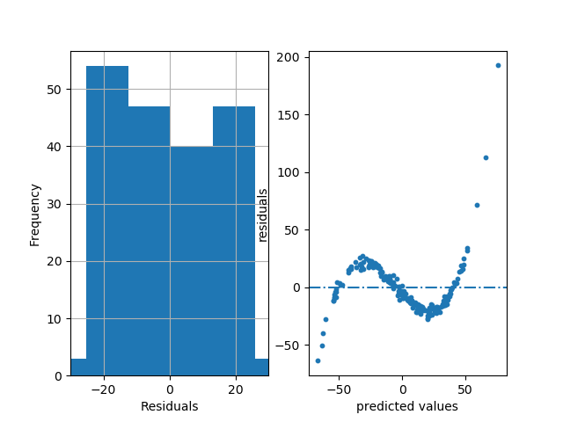
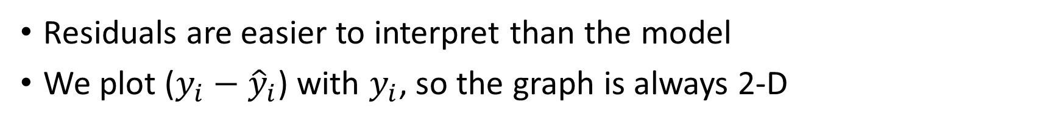
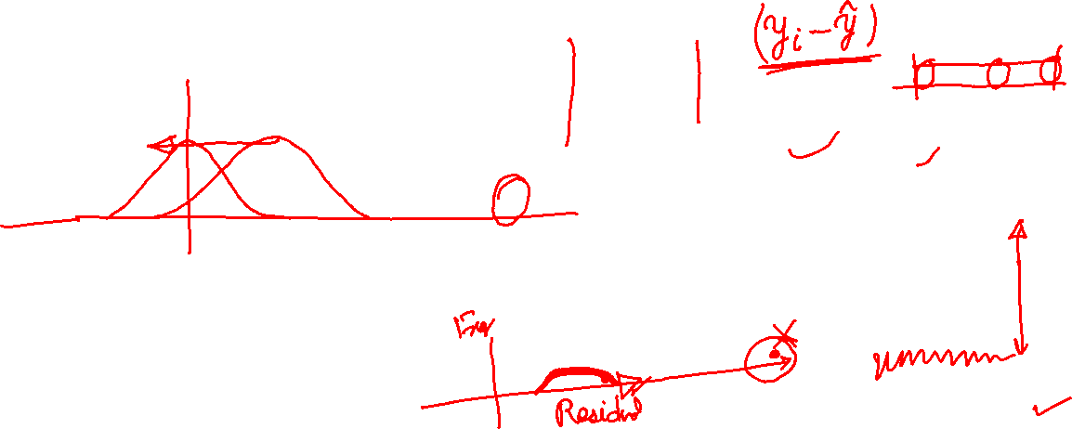
Patterns in Residuals
Residuals are easier to interpret than the model
We plot ($y_{i}−{\hat{y}}_{i}$) with $y_{i}$, so the graph is always 2-D

Slide 49
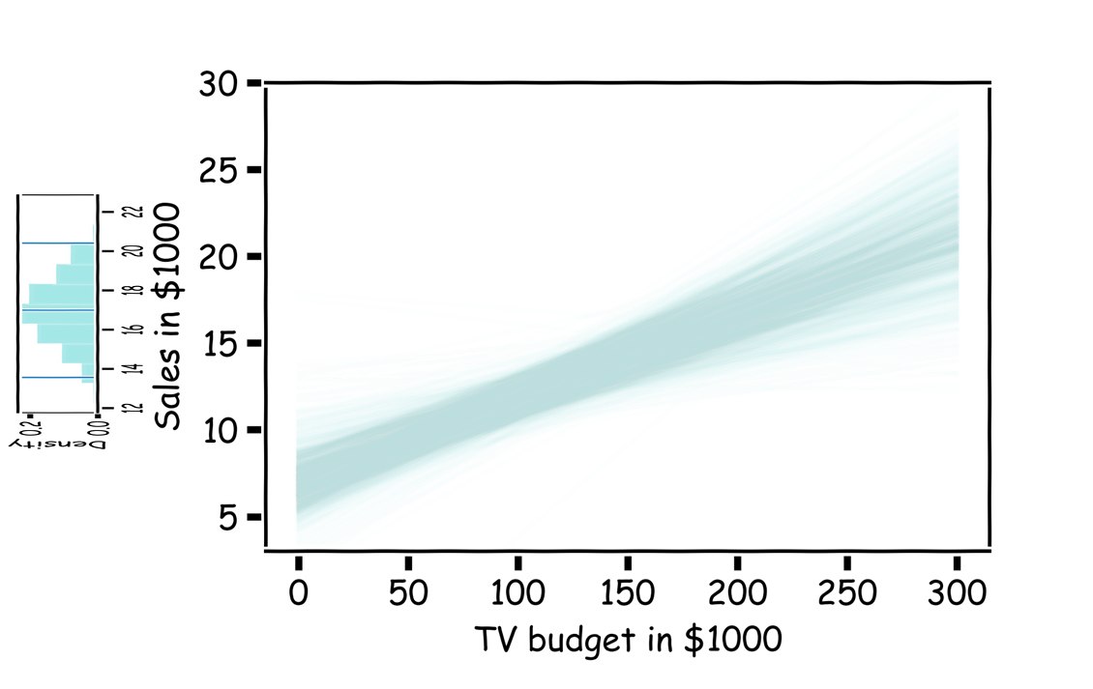
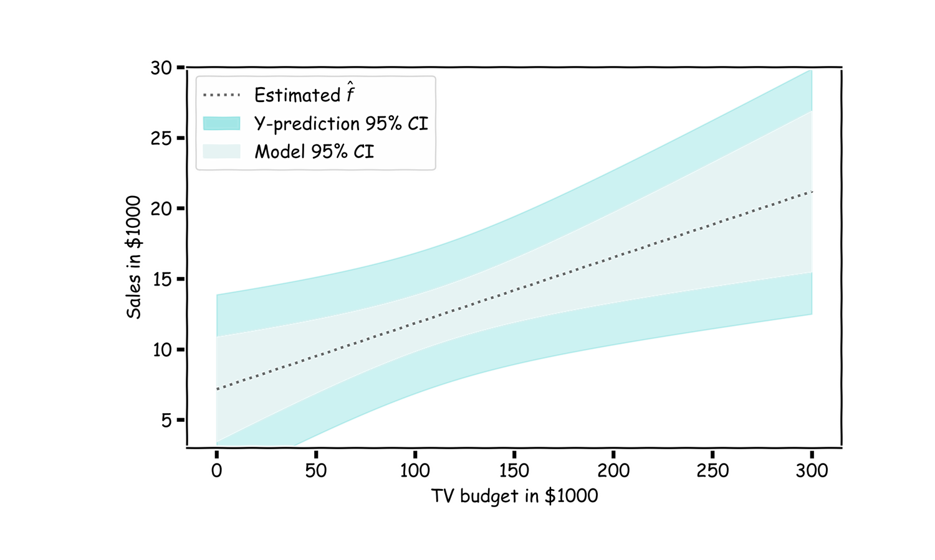
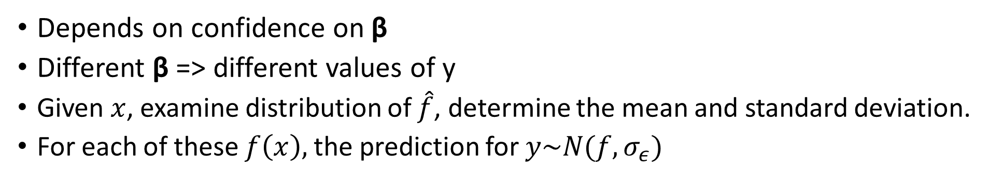
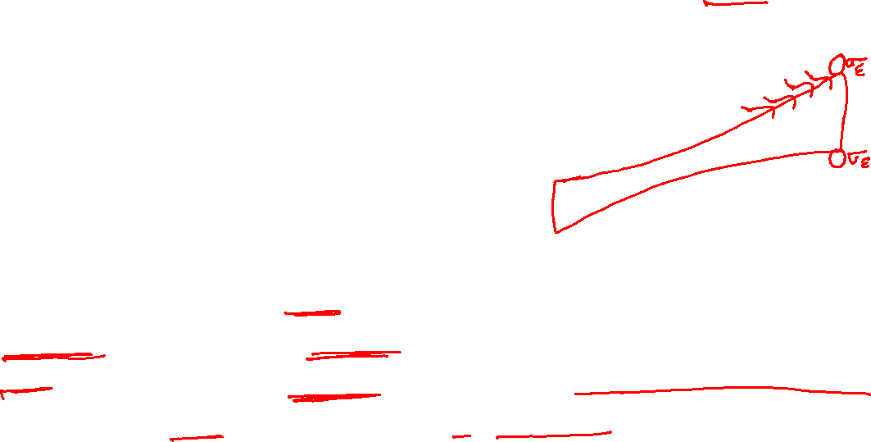
Confidence intervals on predictions of y
Depends on confidence on β
Different β => different values of y
Given $x$, examine distribution of $\hat{f}$, determine the mean and standard deviation.
For each of these $f\left(x\right),$the prediction for $y\sim N(f, σ_{ε})$

Slide 50
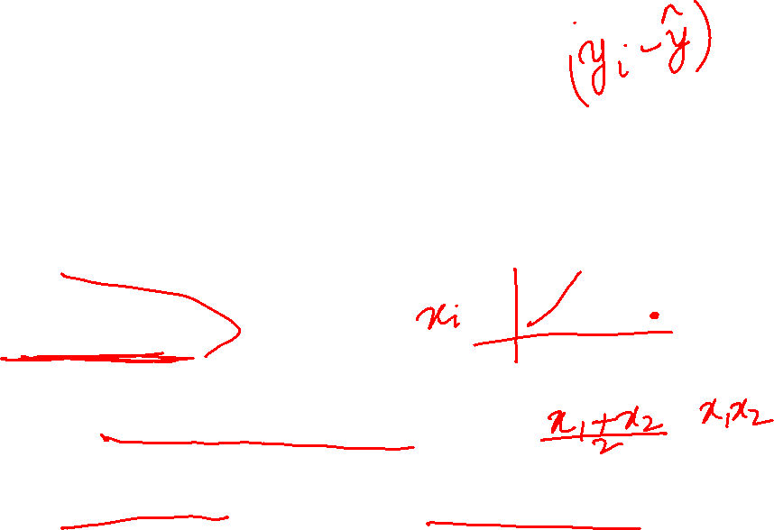
Potential problems of Linear Models
Non-linearity
Can use polynomial linear regression or design better features
Outliers
Disturbs the models because of quadratic penalty, Discard outliers carefully
High-leverage points
Outliers in the predictor variables
Collinearity (2 or more predictor variables have high correlation)
Keep one of them or design a good combined feature
Correlation of error terms, Non-constant variance of error terms
Gives higher confidence in the model, can’t trust the CI on model parameter

Slide 51
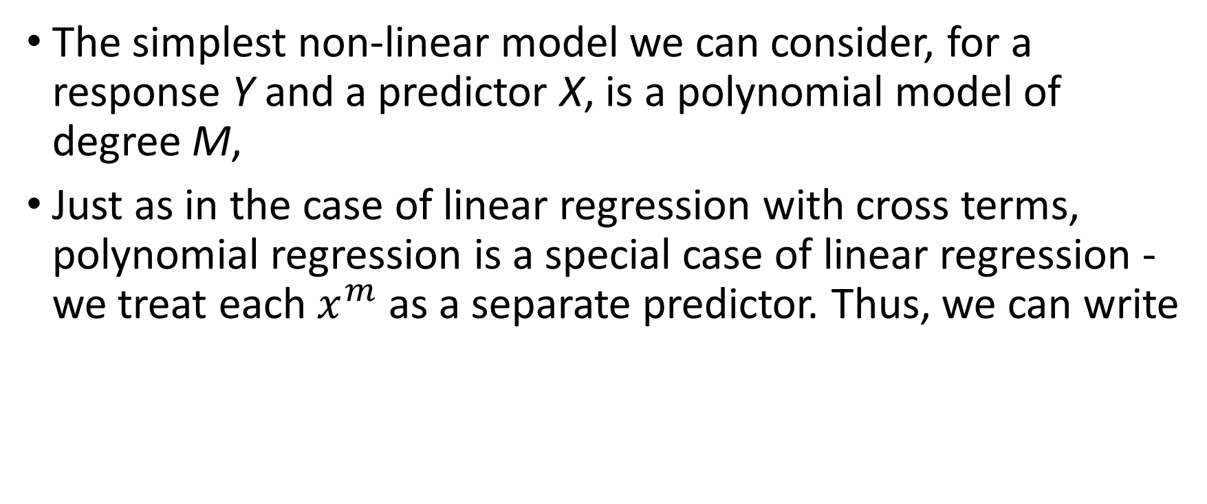

Polynomial Regression
The simplest non-linear model we can consider, for a response Y and a predictor X, is a polynomial model of degree M,
Just as in the case of linear regression with cross terms, polynomial regression is a special case of linear regression - we treat each $x^{m}$ as a separate predictor. Thus, we can write

Slide 52
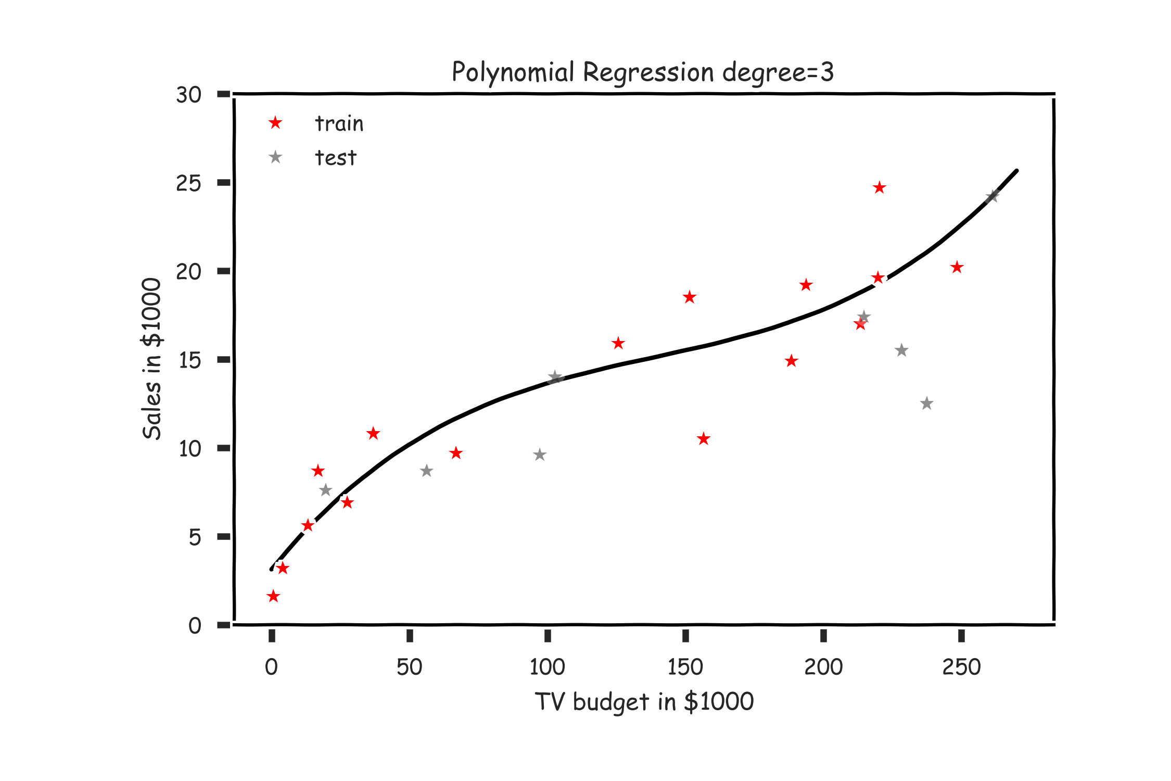
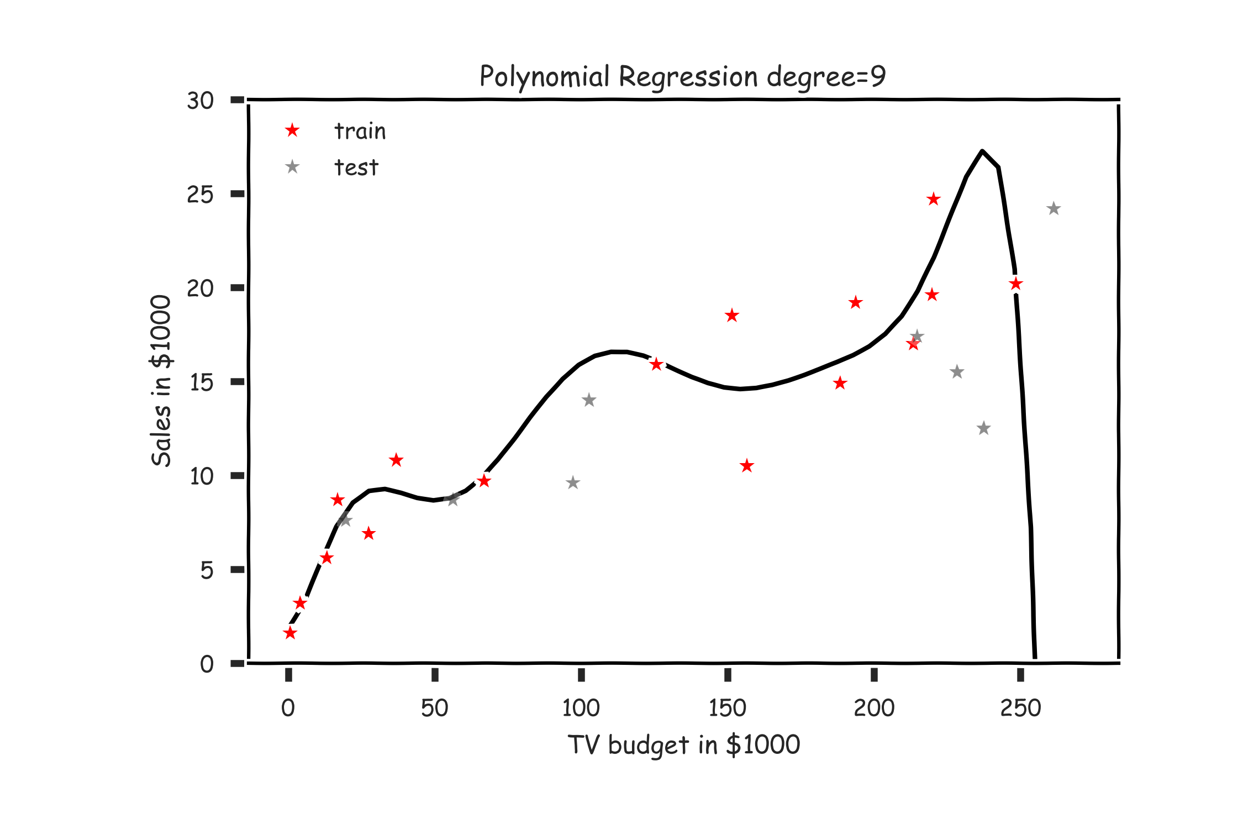
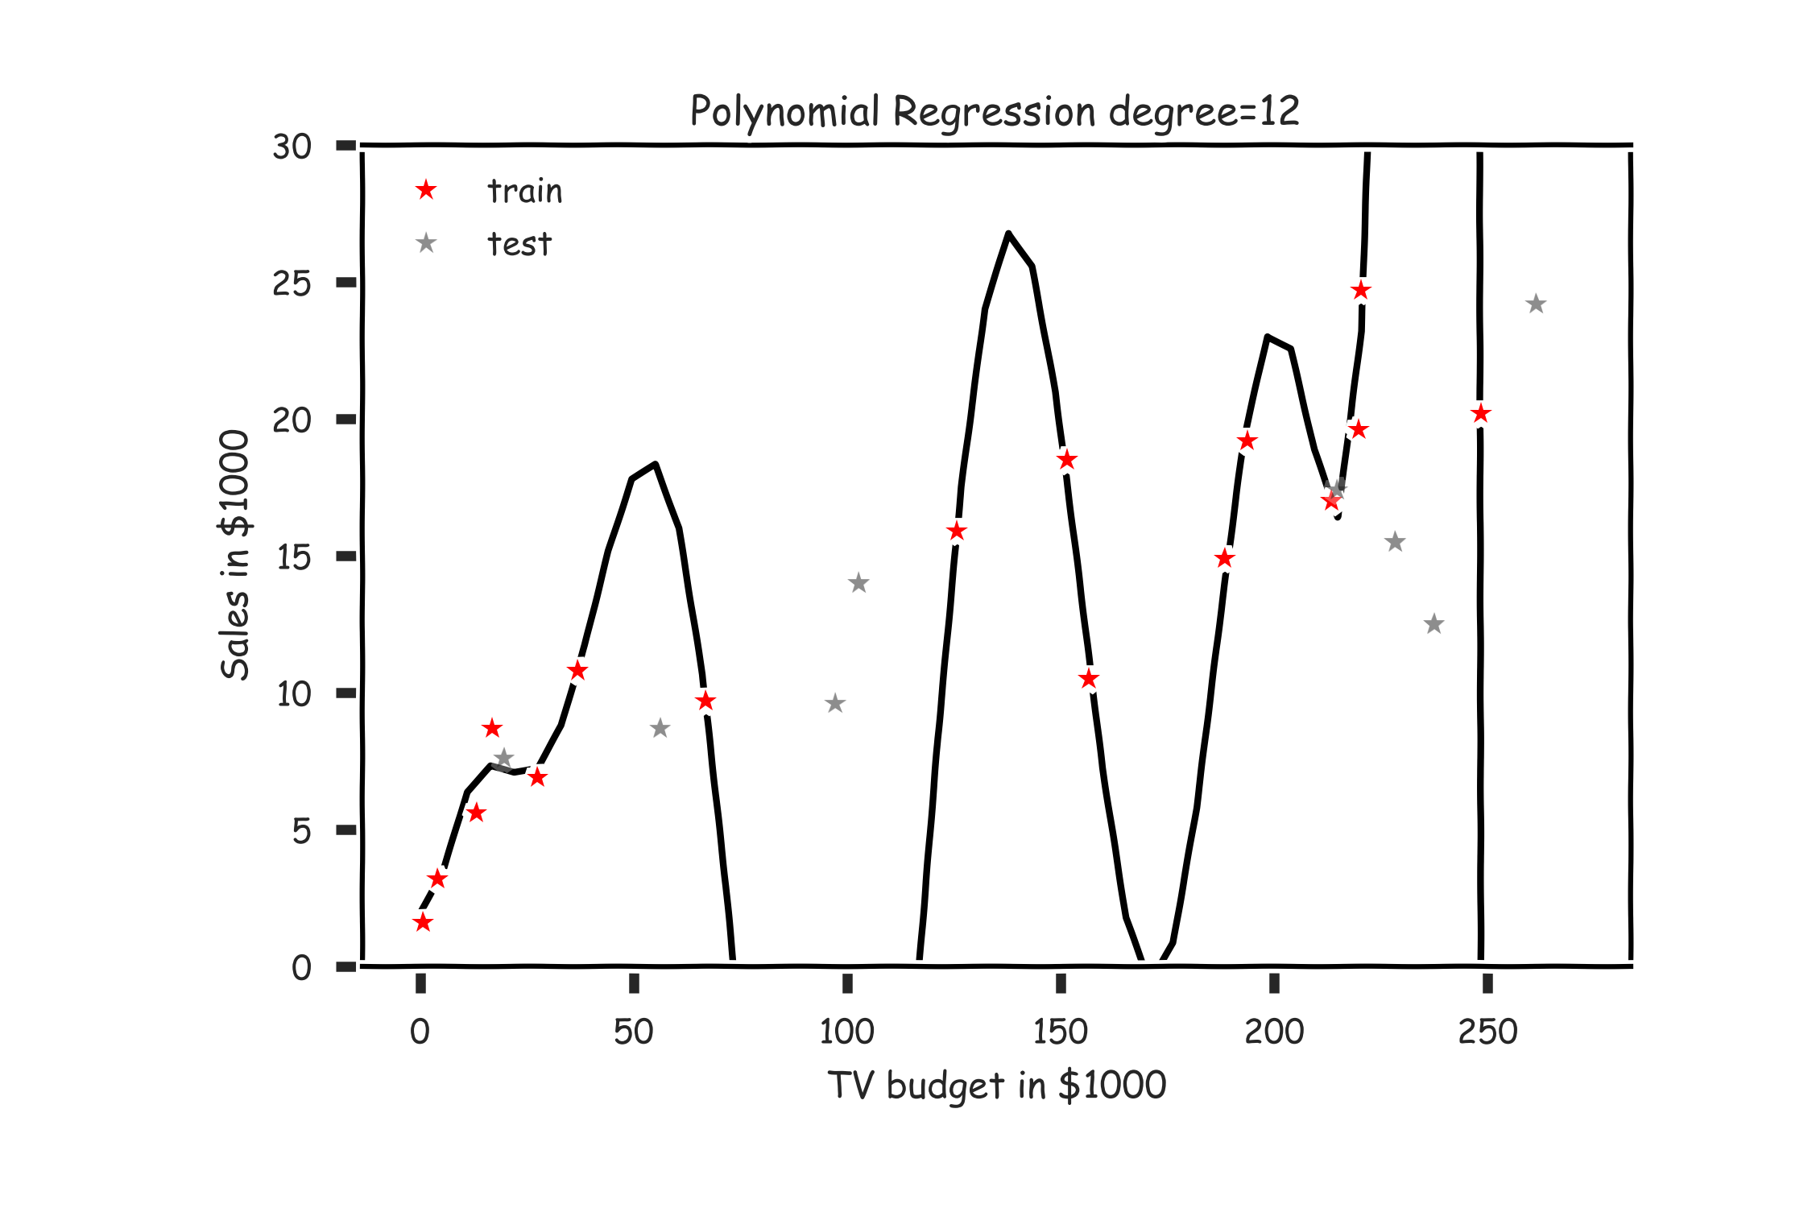
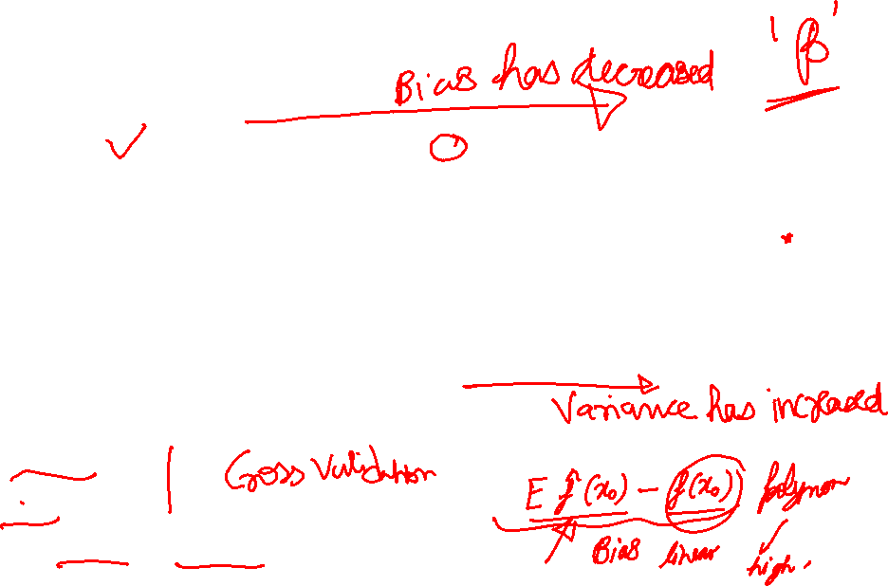
Polynomial Regression
Which of the above three is the best model?
Check RMSE
Check R²
Remember bias and variance??

Slide 53
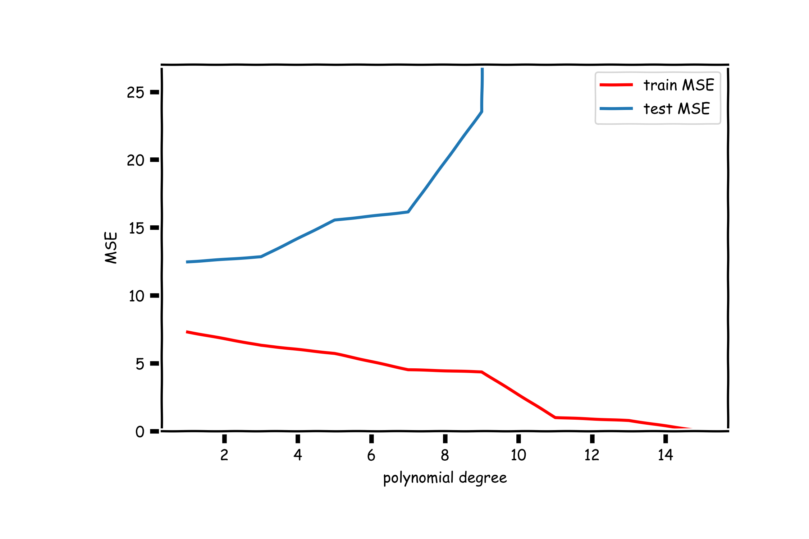
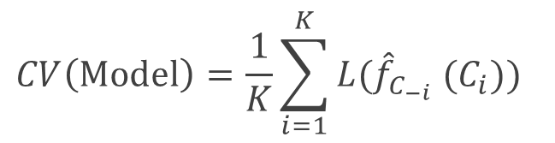

Benefit of Cross-Validation
$$CV\left(Model\right)=\frac{1}{K}\sum_{i=1}^{K}{{L(\hat{f}}_{C_{−i}} (C_{i})\text{)} }$$
Using cross-validation, we generate validate the models on a portion of training data which our learning algorithm has never seen.
Leave-one out method is used when the number of sample points is very small.

Slide 54

Regularization of Linear Models
Goal: Reduce over-fitting of the data by reducing degrees of freedom
For a linear model, regularization is typically achieved by constraining the weights of the model
where $λ$ is a scalar that gives the weight (or importance) of the regularization term.
Fitting the model using the modified loss function L_{reg} would result in model parameters with desirable properties (specified by R).

Slide 55

Ridge Regression
Alternatively, we can choose a regularization term that penalizes the squares of the parameter magnitudes. Then, our regularized loss function is:
Works best when least-square estimates have high variance
As $λ$ increases, flexibility decreases, variance decreases, bias increases slightly
Note that is the l₂ norm of the vector β

Slide 56

Ridge Regression
We often say that L_{ridge} is the loss function for l₂ regularization.
Finding the model parameters β _{ridge} that minimize the l₂ regularized loss function is called ridge regression.

Slide 57
LASSO (least absolute shrinkage and selection operator) Regression
Ridge regression reduces the parameter values but doesn’t force them to go to zero. LASSO is very effective in doing that.
It uses the following regularized loss function is:
Note that is the l₁ norm of the vector β

Slide 58

LASSO Regression
Hence, we often say that L_{LASSO} is the loss function for l₁ regularization.
Finding the model parameters β _{LASSO} that minimize the l₁ regularized loss function is called LASSO regression.

Slide 59

Choosing λ
In both ridge and LASSO regression, we see that the larger our choice of the regularization parameter $λ$, the more heavily we penalize large values in β,
If $λ$ is close to zero, we recover the MSE, i.e. ridge and LASSO regression is just ordinary regression.
If $λ$ is sufficiently large, the MSE term in the regularized loss function will be insignificant and the regularization term will force β _{ridge} and β _{LASSO} to be close to zero.
To avoid ad-hoc choices, we should select $λ$ using cross-validation.
Once the model is trained, we use the unregularized performance measure to evaluate the model’s performance.

Slide 60
Elastic Net
Middle ground between Ridge and Lasso regression
Regularization term is a simple mix with parameter ‘r’
Elastic Net has better convergence features over Lasso.
Sklearn.linear_model import ElasticNet
Elastic_net = ElasticNet(alpha=0.1, l1_ratio=0.5)

